Slide 1
Newton’s First Law of Motion
Dr. Jacob Moore
Associate Professor of Engineering
Penn State Mont Alto

Slide 2
Newton’s First Law
Newton’s First Law states that...
“A body at rest will remain at rest unless acted on by an unbalanced force. A body in motion continues in motion with the same speed and in the same direction unless acted upon by an unbalanced force”

Slide 3
Pre-Newton’s First Law
Prior to Newton, a popular theory of motion was the Aristotelian theory of motion.
In this theory...
Bodies were naturally at rest, and moving bodies will eventually return to rest if left undisturbed.
Continued motion requires the continued action of a force.

Slide 4
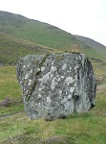
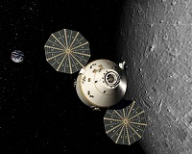
Newton’s First Law
Theories agree in that bodies at rest tend to stay at rest unless acted on by a force.
Theories differ in what happens to bodies in motion.
Either stay in motion (Newton) ...
or eventually come to rest (Aristotle)
Friction is the key to this difference, friction is a force always working to bring objects back to a rest.

Slide 5
Newton’s First Law and the “Net Force”
An important concept to understand as a part of Newton’s First Law is the idea of the “Net Force”
The net force is the sum of all the forces acting on a body.
A non-zero net force, or unbalanced force is needed to change the velocity of the body. If the velocity is changing it has an acceleration.

Slide 6

Newton’s First Law and Rotation
We can also extend Newton’s First Law to rotation…
A body at rest will remain at rest unless acted on by an unbalanced moment. A body in motion continues in motion with the same angular velocity and in the same direction unless acted upon by an unbalanced moment

Slide 7
Thanks for Watching
See other engineering mechanics videos and access the full tool at…

